Slide 1


Bright Coffee Shop
Sales Insights for Growth

Slide 2
Methodology
data Source: Transactional dataset
01
Data analysis-:
SQL queries, pivot tables, dashboards
02
VISUALISATIONS:
CHATS ON EXCEL, TREND ANALYSIS- GRAPHS
03

Slide 3
Revenue Generators

Slide 4
When Customers Buy Most

Slide 5
BEST SELLING SHOPS

Slide 6
BEST SELLER PRODUCTS

Slide 7
Strategic Recommendations

Slide 8
STRATIGIC RECOMMENDATION CONTINUES
Offer “Coffee + Bakery” combos at a slight discount. Since both categories are strong, bundling them increases basket size and encourages upselling.
Use the time-bucket analysis (30–60 min intervals) to identify quieter periods. Offer 10–15% off drinks during those slots to drive foot traffic.
Astoria and Hell’s Kitchen may have different peaks compared to Lower Manhattan. Tailor promotions per store location based on local demand.
Reward repeat purchases in categories that need growth.

Slide 9
Thriving Growth Together
Increase inventory of best-selling items to avoid stock-outs.
Introduce seasonal flavors (pumpkin spice, peppermint mocha) to create urgency.
Implement daily dashboards to monitor performance by product, time, and location- this allow quick adjustments within the business
Promote specials via social media and mobile apps.
Offer mobile ordering discounts to increase convenience and volume.

Slide 10
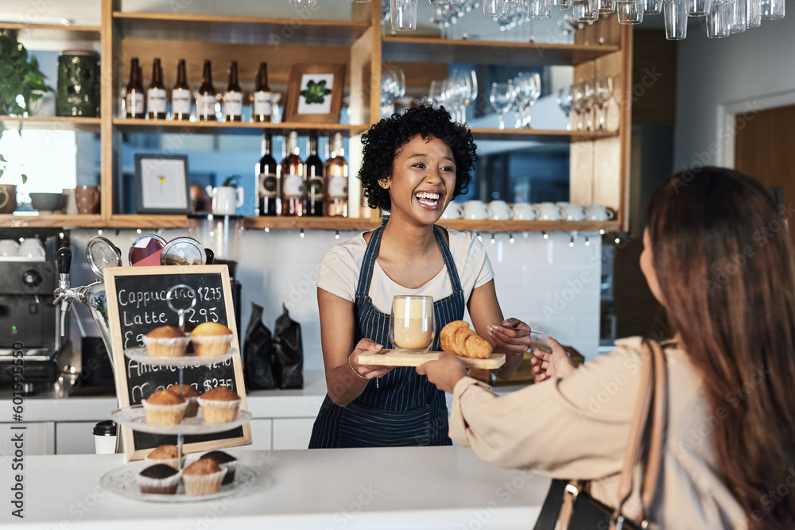
THE END
PLATFORM FOR Q&A

